Slide 1
Warehouse
Management System

Slide 2
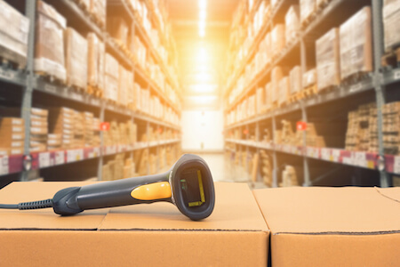
Overall Solution
Warehouse Management Application with RFID /barcode integration for
Inward
Put Away
Inter Location Movements.
Dispatch
WIP

Slide 3
Inward & Put Away

Slide 4
Inward & Put Away
In the Inward process, below mentioned data will be provided.
Vendor Code(10 digit code)
Part No(20 digit code with five section)
Date
Serial No (If needed)
Once we submit the GRN with these details, the system will produce RFID / barcode for each item. After GRN, the parts will move to the system suggested locations (bins). In each stage, system will update all the data into stallion server. So the system will shows only the updated data and we can access anywhere in the world.

Slide 5
Dispatch Pick-list Generation

Slide 6
Dispatch Picking & Transfer to Production/QC

Slide 7
Work-in-progress (WIP)
Component 1
Component 2
WIP_Id
Component 3
Finished Product
Component 4
Component 5

Slide 8
Work-in-progress (WIP)
In WIP application, we can create an Id for each work/Product.
While doing this, the application fetch the data like Wip_Id, User Name, Product Name,
Date and Time, Component Name and Quantity.
Every time while adding the components/Parts, we need to scan the part barcode across the Wip_id.
So each component will be updated to a particular work.
The advantage is that we can easily track,
> The work/Product status .
> What components are used.
> Quantity of each component.
> Replaced components.
> Expected time to complete the work.

Slide 9
Advantages
Accurate storage details.
Online scanners replaced all paper /marking works .
FIFO wise dispatch.
Ware house Wise Stock details .
BIN wise Stock report .
Ware house daily activity dashboard.
More accurate dispatch from Hub to ware houses.
Facility to view the Stock In / Stock Out registers with all fields required and for a given period.
Put away list with available bin location with maximum number of items to be stacked.
Ware House to Warehouse Transfer Details .
Stock across the Organisation – Location wise/Product Category/Product wise/Batch wise.
Integration with Existing System.
Despatch Vs receipt checking helped to minimise the product missing in staging area and also while exporting to customer.

Slide 10
Thank You
THANK Y
For your wathcing

