Slide 1
Bin Trcebality in warehouse premises

Slide 2
Overview
Baically customer want to track the bins inside the warehouse through RFID at IN/OUT Gate .
There are differents type of Bin, and inside the bin there are Honda parts metal/non metal small in size.
Whenever bins will pass through entrance gate with the help of fork lift or pallet our fixed reader (IF1 )will read all bins tags data and send to server for matching .
Bins items are fixed in each bins only we need to count number of bin passing from IN/Out Gate .
Sometimes they have carried in hand some small size cartoon which is also need to track , means whatever bins or cartoon inside that warehous we need to track once same items is passing from entrance gate or exit gate .

Slide 3
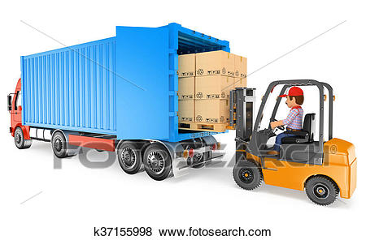
Solution Architecture
IN/OUT Gate
RFID Reader

Slide 4
Hardware Uses
Integrated Redaer IF1C1
RFID Handheld ALR H450
PID-ROBO Inlay Tags
Antenna

Slide 5
Warehouse Managment
An RFID tag is attached to the items either to individual boxes or an entire pallet. At the entrance of the warehouse, there is an RFID channel with many antennas. When a shipment arrives, goes through the channel, the RFID antenna can collect the signal from the RFID tag and transmits the information to a central database
The choose for RFID tags is according to what’s kind of items you are going to track. The material, working temperature, should be a durable or one-time use.

Slide 6
Inventroy Managments in warehouse
The use of RFID for inventory management requires a scanner that uses radio waves to communicate with an RFID tag.
Using RFID tags for inventory management offers several benefits, such as reduced labor costs and faster scanning.
Improved visibility and faster scanning
Reduced labor costs
Tracking of returnable assets
Demanding infrastructure needs
Security concerns.

Slide 7
RFID Inventory through Handheld with PID Robo Inlay RFID Tags
RFID Tag pasting in each Bins

Slide 8
Advantages for using RFID for inventory control
The tags can be read remotely, often at a distance of several metres.
Several tags can be read at once, enabling an entire pallet load of products to be checked simultaneously.
Tags can be given unique identification codes, so that individual products can be tracked
Certain tags can be overwritten, enabling information about items to be updated.

Slide 9
Solution Benifits
RFID System gives proper record of IN/OUT of Bins .
RFID system provide automatic bins record to used , No manual user intervantio.
Increase of miss match bins after use our person can able to serach using handhled or can do physical audit.
Increase dispatch accuracy, efficency and quality .
The GUI Application will display counts of every bins which will passes from reader gate if any mismatch you will get alret message.

Slide 10
Thank You
THANK Y
For your wathcing

