Slide 1
RFID BASED TRACKING & MONITORING
IT’S USAGE
Stallion Systems & Solution Pvt Ltd
Nagendra@stallionindia.com

Slide 2
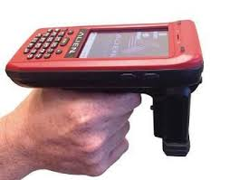

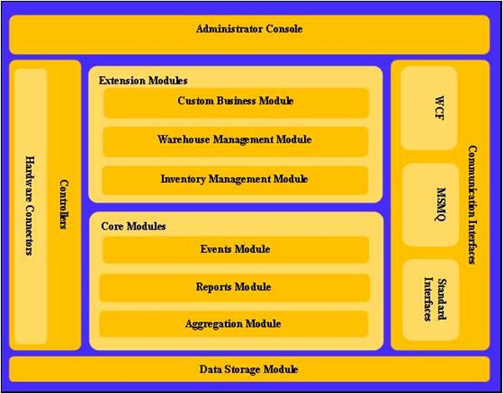
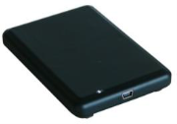

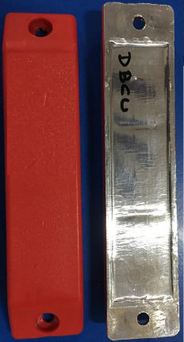
  Our Distinctive Approach
ROBUST HARDWARE
INTELLIGENT MIDDLEWARE SOFTWARE
ENTERPRISE INTEGRATION
…we can integrate with any existing software.
WIP Architecture
ISN Framework
Scalable
Customizable
Software interface to Enterprise system to provide Right Information at the Right Time
Master Data Management
EPCglobal Compliant
High IP Rating
Performance Reliability
Service and Support

Slide 3

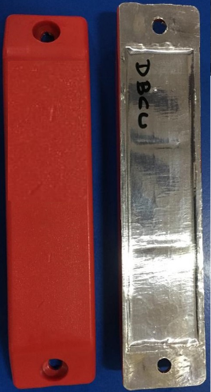
Billboard Registration Point
User will register RFID tag using cloud application & assign data to related to Bill board.

Slide 4
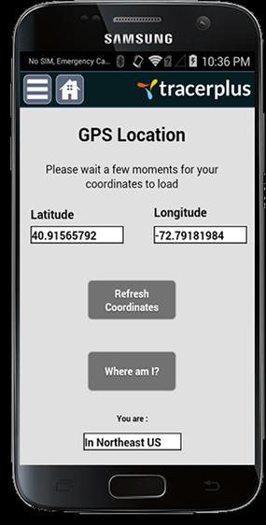

Affixing RFID Tag to Billboard
Related Billboard user will affix RFID tag using Revit/Adhesive. After fixing RFID Tag need to assign GPS location to systems from respective area. All data automatically push to the Web server through GPRS connectivity.

Slide 5


Affixing RFID Tag to Billboard
Whenever user going to install OR Change Billboard sheet that person has to be read Billboard RFID Tag using Alien ALR-H450 device. The device will record few parameters, particular data will push to Web server, from that day application will count start time of advertisement.

Slide 6
Key Features
All Billboard has been digitalize
Billboard Administration person can trace location & assign date of advertisement.
Unauthorized advertisement can be trace easily.
Automated email will generate to renew the advertisement.
Reports can be generated respectively

Slide 7
THANK YOU

